Slide 1
Competitive Factors of
St. Cloud
for Businesses
in Comparison with Comparable Upper Midwest Cities
STAT 381
Claude Lee Hyesu Lee

Slide 2
First-stop for business development assistance
Dedicated to enhancing St. Cloud’s economic vitality and expanding the city’s tax and employment base
St. Cloud Economic Development Authority (EDA)

Slide 3
Project Goal
EDA’s Economic Development Goal
Attract, retain, and grow business through branding and marketing
Our Goal
Provide statistical evidence of competitive factors of St. Cloud for business establishments in comparison to other comparable Upper Midwest cities

Slide 4
Research Question
Competitive Factors of St. Cloud for Businesses
Does St. Cloud offer better Demographic or Economic advantage for Businesses compared to similar upper Midwest cities?
What are some Occupations that present unique characteristics in St. Cloud compared to similar upper Midwest cities?
Comparable Upper Midwest Cities
MN: Rochester, Duluth, Mankato
ND: Fargo, Grand Forks
WI: Eau Claire, La Crosse
IA: Dubuque, Cedar Rapids

Slide 5
Analysis Steps
01
Gather related data that can be classified into metropolitan area
02
Perform statistical analysis in each variable/factor
03
Identify interesting factors and their statistical & practical significance
04
Provide descriptions of competitive factors and its relevance

Slide 6
DATA
American Community Survey (IPUMS)
Unit: Household/Person Yearly data
City Area Approximate: Public Use Microdata Area (PUMA, ≈ County level)
Demographic
Local Area Unemployment Statistics (LAUS)
Unit: Metropolitan Statistical Area, Monthly data (seasonally adjusted)
Economic
Occupational Employment and Wage Statistics (OEWS)
Unit: Metropolitan Statistical Area, Yearly data
Occupation

Slide 7
Question #1
Does St. Cloud offer
better Demographic or Economic advantage for Businesses compared to similar upper Midwest cities?

Slide 8
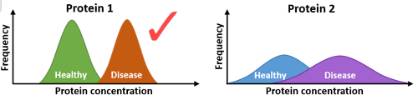
Question #1: Demographic and Economic Characteristics of St. Cloud for Businesses
Methodology – Statistical Method
One-Way Analysis of Variance (ANOVA)
Statistical method of comparing two or more means with respect to their variances
Significant Difference in means
= The difference is extreme considering their variation
Less variant samples ➔ More significantly different in means
Notes:
Source: https://raybiotech.com/learning-center/t-test-anova/

Slide 9
Question #1: Demographic and Economic Characteristics of St. Cloud for Businesses
Methodology – Application
IPUMS
One-Way ANOVA with City Means per Year
Variation: Household/Person*
*IPUMS specifies types of unit based on the nature of variable ex) Household income vs. Personal income
Years: 2017-2019
Multiple comparisons with St. Cloud ➔ How different is St. Cloud from the other 9 cities?
LAUS
One-Way ANOVA with City Means per Year
Variation: Seasonally adjusted 12 months
Years: 2017-2020
Multiple comparisons with St. Cloud (same as IPUMS)

Slide 10
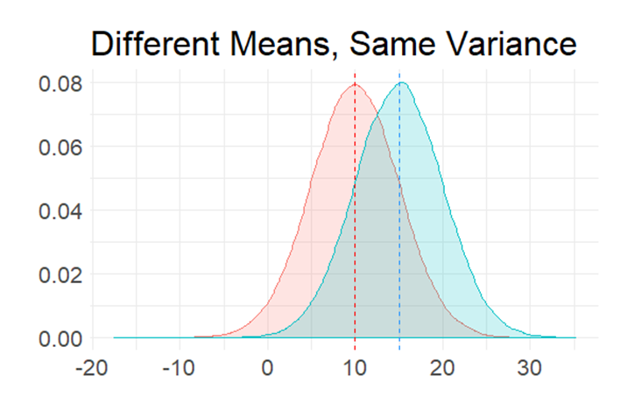
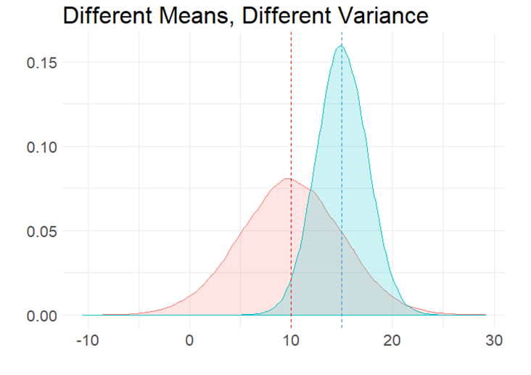
Question #1: Demographic and Economic Characteristics of St. Cloud for Businesses
Methodology – ANOVA
Multiple Comparison
ANOVA Procedure of comparing means in pairs
Which city is significantly different from St. Cloud?
Requires specification of equal/unequal variance between two groups
Notes:
Source: https://bookdown.org/curleyjp0/psy317l_guides5/two-sample-inferential-statistics.html

Slide 11
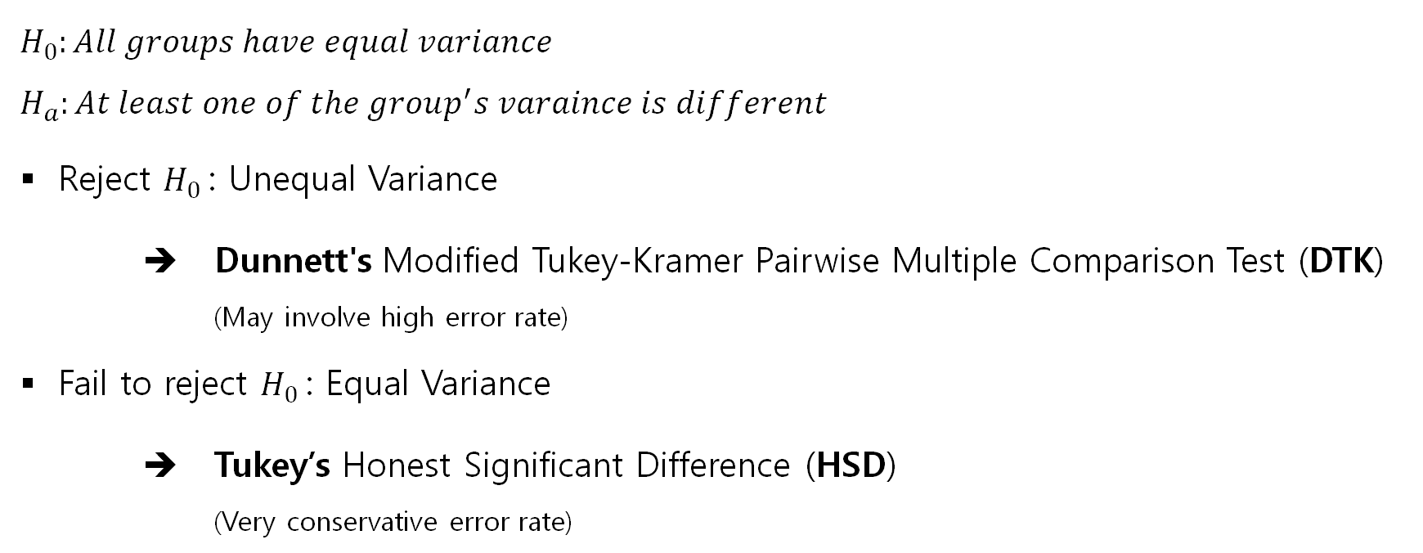
Question #1: Demographic and Economic Characteristics of St. Cloud for Businesses
Methodology – ANOVA
Levene’s Test for Equal Variance
$H_{0}:All groups have equal variance$
$H_{a}:At least one of the group^{′}s varaince is different$
Reject $H_{0}$: Unequal Variance
➔ Dunnett's Modified Tukey-Kramer Pairwise Multiple Comparison Test (DTK)
(May involve high error rate)
Fail to reject $H_{0}$: Equal Variance
➔ Tukey’s Honest Significant Difference (HSD)
(Very conservative error rate)

Slide 12
Question #1: Demographic and Economic Characteristics of St. Cloud for Businesses
Methodology – Identifying Significant Variables
Initial Variable Selection
Generic characteristics
Interpretable and related with EDA’s goal
Significant Variable Selection
Significant differences in consistent direction in all years with at least one city
Consistently significantly low or high in all years
**The presentation only includes significant variables

Slide 13
Question #1: Demographic and Economic Characteristics of St. Cloud for Businesses
Demographic Characteristics
with IPUMS

Slide 14
Average First Mortgage Payment
St. Cloud
One of the highest: significantly greater than the most cities
Significantly less than Rochester, MN & Fargo, ND
(DTK) | 2017 | 2018 | 2019
Rochester, MN
Fargo, ND
Grand Forks, ND
Duluth, MN
Cedar Rapids, IA
La Crosse, WI
Eau Claire, WI
Mankato, MN
Dubuque, IA
In $
(DTK) | 2017 | 2018 | 2019
Rochester, MN | +1* | +1* | +1*
Fargo, ND | +2* | +2* | +2*
Grand Forks, ND | -9* | -5* | -3*
Duluth, MN | -6* | -6* | -4*
Cedar Rapids, IA | -5* | -4* | -5*
La Crosse, WI | +3* | -7* | -6*
Eau Claire, WI | -7* | -8* | -7*
Mankato, MN | +4 | -3 | -8*
Dubuque, IA | -8* | -9* | -9*

Slide 15
Average Gross Rent
St. Cloud
Low to average: no significant difference with the most cities
Significantly less than Rochester, MN, Fargo, ND, and Duluth, MN
In $
(DTK) | 2017 | 2018 | 2019
Duluth, MN | +3* | +3* | +1*
Rochester, MN | +1* | +1* | +2*
Mankato, MN | +2* | +5* | +3
Fargo, ND | +5* | +7* | +4*
Grand Forks, ND | -9* | +4* | +5
La Crosse, WI | +4* | +2* | -6
Eau Claire, WI | -8 | +6* | -7*
Cedar Rapids, IA | +7* | -9* | -8*
Dubuque, IA | +6* | -8* | -9*

Slide 16
Average Family Size
St. Cloud
High to average: no significant difference with the most cities
Significantly greater than Grand Forks, ND & Duluth, MN
(HSD) | 2017 | 2018 | 2019
Rochester, MN | +1 | -2 | -1
Cedar Rapids, IA | +4 | -4 | -2
Dubuque, IA | +2 | -1 | -3
Eau Claire, WI | -5 | -6 | -4
Mankato, MN | -7 | -5 | -5
Grand Forks, ND | -8* | -8* | -6*
Fargo, ND | +3 | -3 | -7*
La Crosse, WI | -6 | -7 | -8*
Duluth, MN | -9* | -9* | -9*

Slide 17
Average Travel Time to Work
St. Cloud
The highest: significantly greater than all cities
In Minutes
(DTK) | 2017 | 2018 | 2019
Cedar Rapids, IA | -5* | -6* | -1*
Dubuque, IA | -3* | -1* | -2*
Eau Claire, WI | -4* | -2* | -3*
Rochester, MN | -6* | -3* | -4*
Fargo, ND | -8* | -9* | -5*
La Crosse, WI | -7* | -7* | -6*
Mankato, MN | -1* | -4* | -7*
Duluth, MN | -2* | -5* | -8*
Grand Forks, ND | -9* | -8* | -9*

Slide 18
Average House Value
St. Cloud
One of the highest: significantly greater than most cities
Significantly less than Rochester, MN & Fargo, ND
In $
(DTK) | 2017 | 2018 | 2019
Rochester, MN | +1* | +1* | +1*
Fargo, ND | +2* | +2* | +2*
Eau Claire, WI | -5* | -5* | -3*
La Crosse, WI | -3 | -4* | -4*
Duluth, MN | -6* | -3* | -5*
Mankato, MN | -4* | -7* | -6*
Cedar Rapids, IA | -8* | -9* | -7*
Grand Forks, ND | -9* | -8* | -8*
Dubuque, IA | -7* | -6* | -9*

Slide 19
Average Age
St. Cloud
One of the lowest: significantly less than the most cities
Significantly greater than Fargo, ND
(DTK) | 2017 | 2018 | 2019
Dubuque, IA | +1* | +1* | +1*
Rochester, MN | +4* | +5* | +2*
Cedar Rapids, IA | +5* | +4* | +3*
Duluth, MN | +7* | +2* | +4*
Eau Claire, WI | +2* | +3* | +5*
La Crosse, WI | +3* | +6* | +6*
Grand Forks, ND | +6* | +7* | +7*
Mankato, MN | -8 | -8 | +8
Fargo, ND | -9* | -9* | -9*

Slide 20
Proportion of Finished Some College
St. Cloud
One of the lowest: significantly less than Rochester, MN, Fargo, ND, Duluth, MN, and Mankato, MN
Significantly greater than Dubuque, IA
(DTK) | 2017 | 2018 | 2019
Duluth, MN | +1* | +3* | +1*
Rochester, MN | +3* | +1* | +2*
Fargo, ND | +2* | +2* | +3*
Grand Forks, ND | +5 | +6* | +4*
Mankato, MN | +4* | +4* | +5*
La Crosse, WI | -6* | +5* | +6*
Cedar Rapids, IA | -8* | -7 | +7*
Eau Claire, WI | -7* | -8* | +8*
Dubuque, IA | -9* | -9* | -9*

Slide 21
Question #1: Demographic and Economic Characteristics of St. Cloud for Businesses
Economic Characteristics
with LAUS

Slide 22
Labor Force Participation
St. Cloud
Around average: # of significantly greater cities ≈ # of significantly less cities
Population
(DTK) | 2017 | 2018 | 2019
Cedar Rapids, IA | +2* | +1* | +1*
Duluth, MN | +1* | +2* | +2*
Fargo, ND | +3* | +3* | +3*
Rochester, MN | +4* | +4* | +4*
Eau Claire, WI | -5* | -5* | -5*
La Crosse, WI | -6* | -6* | -6*
Mankato, MN | -7* | -7* | -7*
Dubuque, IA | -9* | -8* | -8*
Grand Forks, ND | -8* | -9* | -9*

Slide 23
Total Employment
St. Cloud
Around average: same as Labor Force Participation
(DTK) | 2017 | 2018 | 2019
Fargo, ND | +3* | +3* | +3*
Cedar Rapids, IA | +2* | +1* | +1*
Duluth, MN | +1* | +2* | +2*
Rochester, MN | +4* | +4* | +4*
Eau Claire, WI | -5* | -5* | -5*
La Crosse, WI | -6* | -6* | -6*
Mankato, MN | -7* | -7* | -7*
Grand Forks, ND | -8* | -9* | -9*
Dubuque, IA | -9* | -8* | -8*
Population

Slide 24
Unemployment Rate
St. Cloud
One of the highest: significantly greater than the most cities
Significantly less than Duluth, MN
(DTK) | 2017 | 2018 | 2019
Duluth, MN | +1* | +1* | +1*
Cedar Rapids, IA | -2 | -2* | -4*
Eau Claire, WI | -3* | -3* | +2
Dubuque, IA | -4* | -7* | -8*
La Crosse, MN | -5* | -5* | -3*
Rochester, MN | -6* | -6* | -5*
Mankato, MN | -8* | -8* | -7*
Grand Forks, ND | -7* | -4* | -6*
Fargo, ND | -9* | -9* | -9*

Slide 25
Question #1: Demographic and Economic Characteristics of St. Cloud for Businesses
Summary
Competitive Characteristics
Gross Rent: low to average
Age: one of the lowest
Unfavorable Characteristics
First Mortgage Payment: one of the highest
Value of House: one of the highest
Finished Some College: one of the lowest
Questionable Characteristics
Family size: high to average
Travel Time to Work: the highest
Total Employment & LF Participation : average
Unemployment Rate: one of the highest

Slide 26
Question #2
What are some Occupations
that present unique characteristics in St. Cloud compared to similar upper Midwest cities?

Slide 27
Question #2: Unique Occupational Characteristics of St. Cloud
Methodology – Statistical Method
Wilcoxon Signed-Rank Test
Statistical method of comparing median of a group to a specific value
Efficient for small data (nonparametric data)
Signed ranking of values as variance
Significant Difference in median
= The median is extremely different considering their variation
Direction (low/high) is not tested (find on the graph)

Slide 28
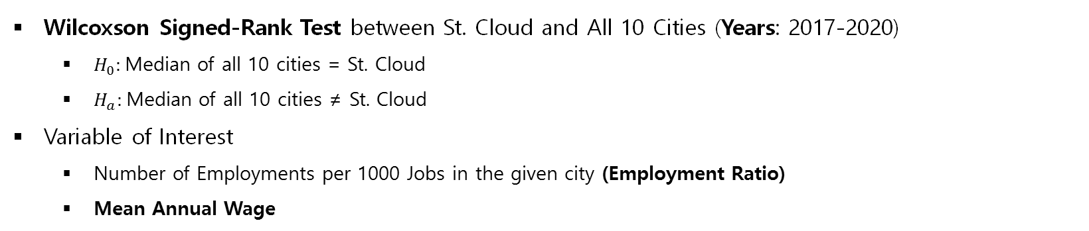
Question #2: Unique Occupational Characteristics of St. Cloud
Methodology – Application
Occupations in Major Classifications
Wilcoxson Signed-Rank Test between St. Cloud and All 10 Cities (Years: 2017-2020)
$H_{0}:$Median of all 10 cities = St. Cloud
$H_{a}:$Median of all 10 cities ≠ St. Cloud
Variable of Interest
Number of Employments per 1000 Jobs in the given city (Employment Ratio)
Mean Annual Wage
Noticeable Occupations in Subclassification
One of the highest or lowest (St. Cloud ratio / US ratio) Quotient
Same testing as above

Slide 29
Question #2: Unique Occupational Characteristics of St. Cloud
Methodology – Identifying Significant Occupations
Initial Occupation Selections
Major classifications: all
Detailed subclassifications: Quotient less than lower quartile & greater than upper quartile
w/ at least 0.1% of total employment of St. Cloud
Significant Occupation Selection
Consistently significantly low or high in all years either in ratio or wage
**The presentation only includes significant occupations

Slide 30
Question #2: Unique Occupational Characteristics of St. Cloud
Unique Occupations in
Major Classifications

Slide 31
Architecture and Engineering
St. Cloud
Lowest then sharp increasing in ratio
One of the lowest in wage
 | 2017 | 2018 | 2019 | 2020
Ratio | 0.01562 | 0.01562 | 0.04688 | 0.125
Wage | 0.01562 | 0.03125 | 0.01562 | 0.03125
Per 1000 Jobs
Wage in $

Slide 32
Life, Physical, and Social Science
St. Cloud
The highest in ratio
 | 2017 | 2018 | 2019 | 2020
Ratio | 0.03125 | 0.01562 | 0.04688 | 0.2812
Wage
Per 1000 Jobs

Slide 33
Community and Social Services
St. Cloud
One of the lowest in ratio
One of the highest in wage
 | 2017 | 2018 | 2019 | 2020
Ratio | 0.03125 | 0.09375 | 0.03125 | 0.01562
Wage | 0.09375 | 0.04688 | 0.01562 | 0.01562
Per 1000 Jobs
Wage in $

Slide 34
Protective Service
St. Cloud
The lowest in ratio; steady then slight increase in 2020
One of the highest in wage; increasing then slight decrease in 2020
 | 2017 | 2018 | 2019 | 2020
Ratio | 0.01562 | 0.01562 | 0.01562 | 0.09375
Wage | 0.01562 | 0.01562 | 0.01562 | 0.1719
Per 1000 Jobs
Wage in $
St. Cloud, MN

Slide 35
Food Preparation and Servicing Related
St. Cloud
One of the lowest in ratio
One of the highest in wage
 | 2017 | 2018 | 2019 | 2020
Ratio | 0.125 | 0.01562 | 0.01562 | 0.01562
Wage | 0.01562 | 0.01562 | 0.03125 | 0.0625
Per 1000 Jobs
Wage in $

Slide 36
Building and Grounds Cleaning and Maintenance
St. Cloud
The highest in wage
 | 2017 | 2018 | 2019 | 2020
Ratio
Wage | 0.03125 | 0.01562 | 0.01562 | 0.01562
Wage in $

Slide 37
Construction and Extraction
St. Cloud
One of the highest in ratio
 | 2017 | 2018 | 2019 | 2020
Ratio | 0.09375 | 0.04688 | 0.03125 | 0.1719
Wage
Per 1000 Jobs

Slide 38
Installation, Maintenance, and Repair
St. Cloud
One of the lowest
 | 2017 | 2018 | 2019 | 2020
Ratio
Wage | 0.03125 | 0.01562 | 0.03125 | 0.04688
Wage in $

Slide 39
Production
St. Cloud
The highest in ratio
 | 2017 | 2018 | 2019 | 2020
Ratio | 0.01562 | 0.01562 | 0.01562 | 0.01562
Wage
Per 1000 Jobs

Slide 40
Transportation and Material Moving
St. Cloud
The second highest in ratio
 | 2017 | 2018 | 2019 | 2020
Ratio | 0.01562 | 0.03125 | 0.01562 | 0.03125
Wage
Per 1000 Jobs

Slide 41
Question #2: Unique Occupational Characteristics of St. Cloud
Occupations in
Subclassifications with
Lower Quartile
Ratio Quotient

Slide 42
First-Line Supervisors of Transportation & Material Moving Workers, Except Aircraft Cargo Handling Supervisors
Under protective service
St. Cloud
One of the highest in wage; slightly decreasing
 | 2017 | 2018 | 2019 | 2020
Ratio
Wage | 0.01562 | 0.01562 | 0.04688 | 0.1719
Wage in $

Slide 43
Landscaping and Groundskeeping Workers
Under Building and Grounds Cleaning and Maintenance
St. Cloud
One of the lowest in ratio
One of the highest in wage; sharply increasing
 | 2017 | 2018 | 2019 | 2020
Ratio | 0.01562 | 0.01562 | 0.09375 | 0.01562
Wage | 0.4219 | 0.2812 | 0.01562 | 0.01562
Per 1000 Jobs
Wage in $

Slide 44
Question #2: Unique Occupational Characteristics of St. Cloud
Occupations in
Subclassifications with
Upper Quartile
Ratio Quotient

Slide 45
Bartenders
Under Food Preparation and Serving Related
St. Cloud
One of the lowest in ratio
 | 2017 | 2018 | 2019 | 2020
Ratio | 0.03125 | 0.01562 | 0.04688 | 0.125
Wage
Per 1000 Jobs
Notes:
Bartenders!

Slide 46
Heavy and Tractor – Trailer Truck Drivers
Under Transportation and Material Moving
St. Cloud
One of the lowest in ratio
 | 2017 | 2018 | 2019 | 2020
Ratio | 0.01562 | 0.04688 | 0.01562 | 0.04688
Wage
Per 1000 Jobs

Slide 47
Licensed Practical & Licensed Vocational Nurses
Under Healthcare Practitioners and Technical
St. Cloud
One of the highest in ratio; increasing
 | 2017 | 2018 | 2019 | 2020
Ratio | 0.125 | 0.03125 | 0.0625 | 0.03125
Wage
Per 1000 Jobs

Slide 48
Operating Engineers & Other Construction Equipment Operators
Under Construction and Extraction
St. Cloud
One of the highest in ratio
 | 2017 | 2018 | 2019 | 2020
Ratio | 0.01562 | 0.03125 | 0.01562 | 0.09375
Wage
Per 1000 Jobs

Slide 49
Plumbers, Pipefitters, & Steamfitters
Under Construction and Extraction
St. Cloud
One of the highest in ratio
 | 2017 | 2018 | 2019 | 2020
Ratio | 0.01562 | 0.01562 | 0.01562 | 0.01562
Wage
Per 1000 Jobs

Slide 50
Welders, Cutters, Solderers, and Brazers
Under Production
St. Cloud
One of the highest in ratio; decreasing
 | 2017 | 2018 | 2019 | 2020
Ratio | 0.01562 | 0.01562 | 0.01562 | 0.01562
Wage
Per 1000 Jobs

Slide 51
Question #2: Unique Occupational Characteristics of St. Cloud
Summary – Major Classifications
 | Job Ratio | Annual Mean Wage
High | Life, Physical, and Social Science – highest Production – highest Transportation and Material Moving – second highest Construction and Extraction – 3 high quotients | Building and Grounds Cleaning and Maintenance – highest, 3 low quotients Protective Service Community and Social Services Food Preparation and Servicing Related
Low | Protective Service – lowest Community and Social Services Food Preparation and Servicing Related | Installation, Maintenance, and Repair Architecture and Engineering
Interesting Pattern | Architecture and Engineering – sharp increase

Slide 52
Question #2: Unique Occupational Characteristics of St. Cloud
Summary – Subclassifications Upper/Lower Quartile Quotient
 | Job Ratio | Annual Mean Wage
High | High Quotient Construction and Extraction Operating Engineers & Other Construction Equipment Operators Plumbers, Pipefitters, & Steamfitters Welders, Cutters, Solderers, and Brazers Low Quotient Healthcare Practitioners and Technical Licensed Practical & Licensed Vocational Nurses | Low Quotient Building and Grounds Cleaning and Maintenance First-Line Supervisors of Transportation & Material Moving Workers, Except Aircraft Cargo Handling Supervisors Landscaping and Groundskeeping Workers
Low | High Quotient Transportation and Material Moving Heavy and Tractor – Trailer Truck Drivers Food Preparation and Servicing Related Bartenders Low Quotient Building and Grounds Cleaning and Maintenance Landscaping and Groundskeeping Workers

Slide 53
Key Insights
Demographic and Economic
컨텐츠에 대한 내용을 적어요
High family size with the lowest population age, but low college education attainment
High house and mortgage values but low rent
The highest travel time to work
The highest unemployment rate

Slide 54
Key Insights
Occupations
컨텐츠에 대한 내용을 적어요
Low # jobs high wage:
Protective Service
Community and Social Services
Food Preparation and Servicing Related
Landscaping and Groundskeeping Workers
Architecture and engineering: sharp increase of # jobs but low wage
Sharp drop in Rochester’s wage
High # jobs in industrial manual labors:
Construction and Extractions, Production, Transportation and Material Moving

Slide 55
Suggestions for Future Analysis
Why is travel time to work in St. Cloud so high?
Due to better job opportunities in the twin cities?
Where do people go to work?
What causes high unemployment rate in St. Cloud?
Lack of job opportunities vs. Unwillingness to work
Why is the college education attainment is so low in St. Cloud?
The lowest population age, but low college graduate proportions

Slide 56
Suggestions for Future Analysis
Why some occupations have low # of jobs but high wage?
Protective Service, Community and Social Services, Food Preparation and Servicing Related, Landscaping and Groundskeeping Workers
What happened to Architecture and Engineering industry in MN?
Sharp increase of # of jobs
Sudden drop of wage in Rochester
What sources high # of Manual Labor jobs in St. Cloud
High # of manual labor jobs

Slide 57
Limitation
컨텐츠에 대한 내용을 적어요
Control of DTK error rate (Conservative Tukey’s HSD)
IPUMS’s city areas (PUMA) do not match LAUS/OEWS’s Metropolitan Statistical Areas (MSA)
Unable to test for all years (2012-2020)

